Slide 1
Online booking ticket website
Presented by: Jana Mahdy, Jomana Hesham, Joury Ashry, Laila Mohamed, Laila Elsharkawy, and Nadine Basha

Slide 2
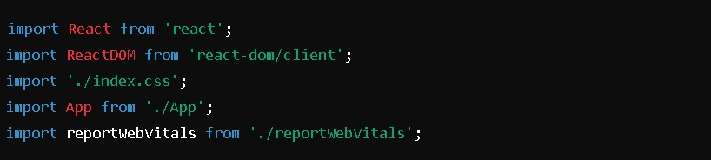
Index.JS
This index.js file is the entry point for the React application. It is where the React app is mounted onto the DOM, and where important configurations (like performance measurement) are initialized.
import React from 'react';: This imports the React library. While React is not explicitly used in the code, it is necessary for JSX syntax, which is used to describe UI in the App component.
import ReactDOM from 'react-dom/client';: This imports the ReactDOM library, which is used to render React components into the DOM. In this case, the createRoot method is being used to render the app.
import './index.css';: This imports the global CSS file (index.css) to apply styles throughout the application.
import App from './App';: This imports the root App component which contains the main logic of the application.
import reportWebVitals from './reportWebVitals';: This imports a utility function that allows you to measure and log the app's performance.

Slide 3
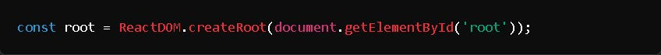
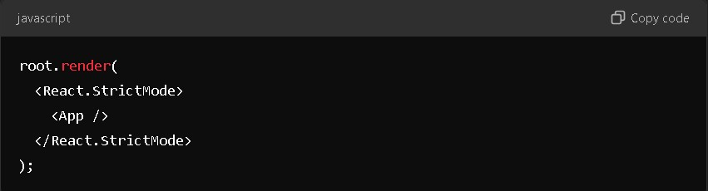
Creating root element and rendering the app
This line selects the HTML element with the ID root (usually in public/index.html).
ReactDOM.createRoot(): This method is used in React 18 and later to create a root React container where the app will be rendered.
root.render(): This renders the React application into the root element on the page.
<React.StrictMode>: A wrapper component that helps identify potential problems in the app by running additional checks and warnings in development mode.
<App />: This is the root component of your React app. The entire application UI is usually defined inside this component.

Slide 4
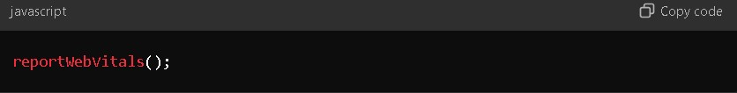
Performance measurement
This index.js file is responsible for:
Importing necessary libraries and styles.
Creating the React root element where the app will be rendered (document.getElementById('root')).
Rendering the app (<App />) inside a React.StrictMode wrapper.
Optionally measuring the app's performance using reportWebVitals().
This is a basic setup for initializing a React application, and it is commonly found in projects created with tools like Create React App.
This is a utility function provided by Create React App to measure the performance of your app. It collects data about the app’s performance (such as page load time, resource load time, etc.) and can send this data to an analytics endpoint or log it to the console.
In this case, reportWebVitals() is being called without any arguments, meaning performance metrics are not being logged or sent anywhere by default.

Slide 5
App.js
React application that sets up routing for a web app using react-router-dom. The app includes routes for login, landing page, booking tickets, and viewing ticket history. It also utilizes Bootstrap for styling.
React: Core library for building the user interface.
React-router-dom: Used for handling navigation between different pages of the app.
Bootstrap: Provides responsive and pre-designed CSS components for styling the app.
LoginPage.js: Component for the login page.
LandingPage.js: Component for the landing page, typically shown after login.
BookTicket.js: Component for booking tickets.
TicketHistory.js: Component for viewing ticket history.
App.js: Main entry point for the app, where routes are defined.
Index.js: Renders the App component into the DOM.

Slide 6
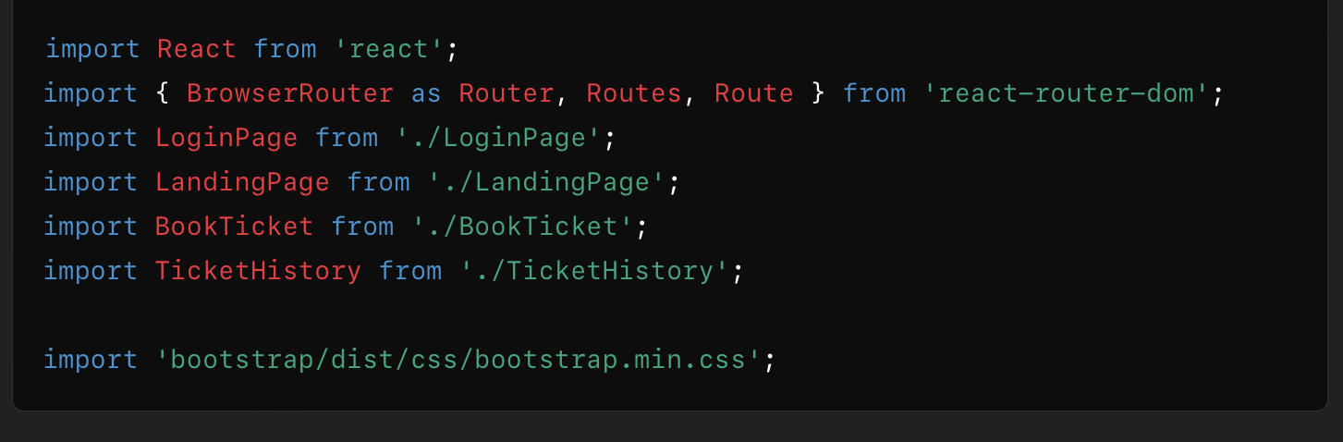
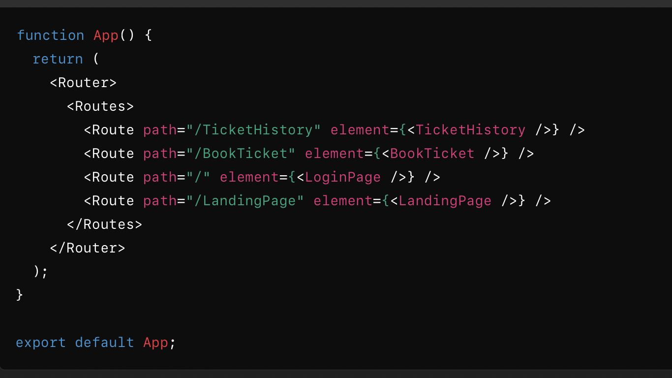
Import statements and main app component
React: Used to create React components.
BrowserRouter (as Router): Manages routing in a React application.
Routes and Route: Define individual routes and their corresponding components.
Bootstrap: Provides pre-defined styles for UI components.
Features:
Router:
Wraps the application to enable routing functionality.
Routes:
Defines a list of routes and their respective components.
Route Definitions:
/TicketHistory: Displays the TicketHistory component for viewing previously booked tickets.
/BookTicket: Displays the BookTicket component for booking tickets.
/: The default route, which renders the LoginPage component.
/LandingPage: Displays the LandingPage component, typically after login.
Component Export:
App is exported as the default component, allowing it to be imported and rendered in index.js.

Slide 7
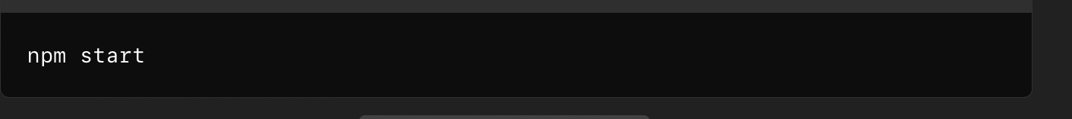
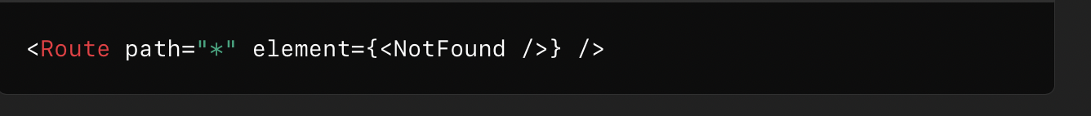
Styling and running the application
Imports the Bootstrap stylesheet for styling components. This ensures the app has a modern, responsive design.
Make sure all dependencies are installed.
Run the development server:
Navigation:
Home (/): Opens the login page.
Landing Page (/LandingPage): Displays the main dashboard or welcome screen.
Book Ticket (/BookTicket): Navigate to the ticket booking page.
Ticket History (/TicketHistory): Navigate to the page showing a list of booked tickets.
This code defines a catch-all route in React Router that renders the <NotFound /> component for any undefined paths, typically for handling 404 errors.

Slide 8
LoginPage.JS
The Login Page is a React component that provides a user interface for authenticating users. It captures the email and password input, validates the data, sends a login request to a backend server, and handles the server response (success or error).
Technologies Used:
React - JavaScript library for building the user interface.
React Router - For navigation between pages.
JavaScript ES6+ - Modern JavaScript syntax.
CSS - Styling for the login page (LoginPage.css).
Fetch API - Used for HTTP communication with the backend.
Purpose:
The login page is designed for:
User Authentication: Allowing users to log in using their credentials (email and password).
Error Handling: Informing users of input errors, failed login attempts, or server issues.
Navigation: Redirecting users to another page (LandingPage) after a successful login.

Slide 9
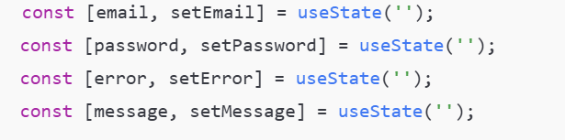
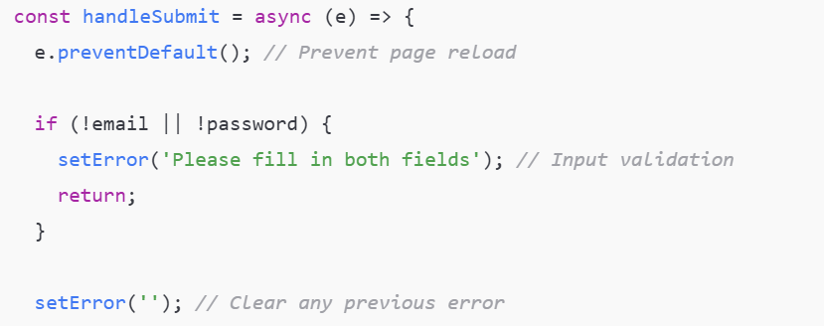
State initialization and form submission
The component uses React's useState to manage form inputs, errors, and success messages.
email: Holds the user's email input.
password: Holds the user's password input.
error: Displays error messages (e.g., validation issues or server errors).
message: Displays success messages after a successful login.
The handleSubmit function manages the form submission and validates user inputs.
Validation: Checks for empty fields and sets an error message if inputs are missing.

Slide 10
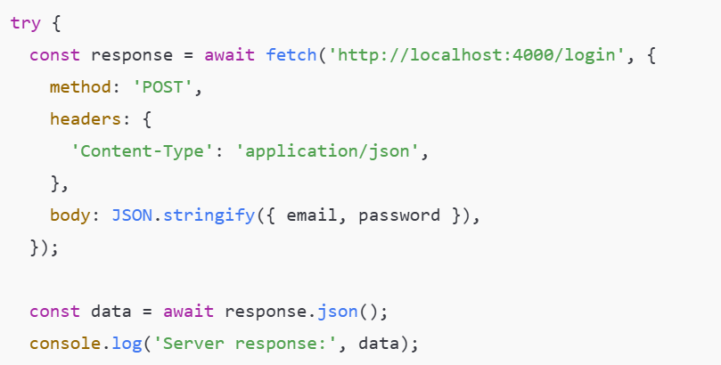
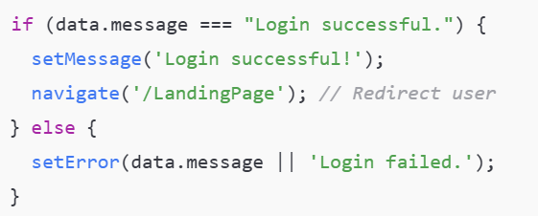
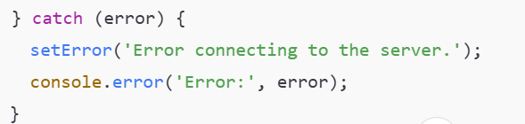
Server communication and handling errors
The fetch API sends a POST request to the backend with the email and password.
If the server sends "Login successful.", a success message is displayed, and the user is redirected.
If the login fails, the error message returned by the server is displayed.
The component handles success and error responses:
Success: Redirects the user to /LandingPage.
Error: Displays an error message (e.g., "Login failed").
In case of network issues or server errors:

Slide 11
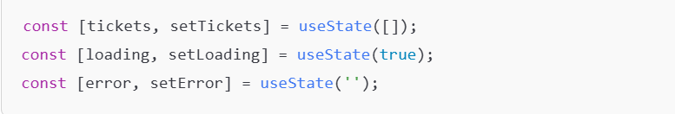
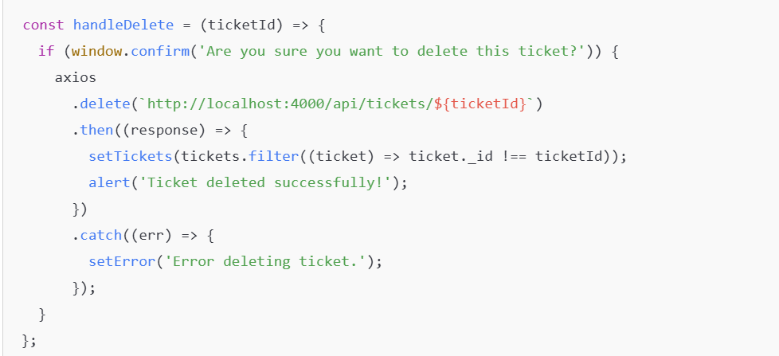
Admin page
State management is a critical part of this React component as it ensures that the user interface (UI) reflects the correct data and reacts dynamically to user interactions. In this component, React's useState hook is used to manage three pieces of state

Slide 12
Delete feature
The delete ticket feature lets the admin remove a ticket from the system. Here’s how it works:
Confirmation:
When the admin clicks the Delete button, a pop-up asks, "Are you sure?"
If the admin clicks OK, the process starts. If they click Cancel, nothing happens.
Deleting the Ticket:
A DELETE request is sent to the backend to remove the ticket.
The system uses the ticket’s ID to know which one to delete.
Updating the Screen:
If the ticket is deleted successfully:
The ticket is removed from the list using a filter, which hides it from the table.
A success message appears saying, "Ticket deleted successfully!"
If something goes wrong (e.g., server error):
An error message is shown, like "Error deleting ticket."

Slide 13
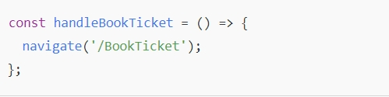
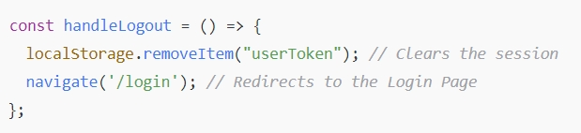
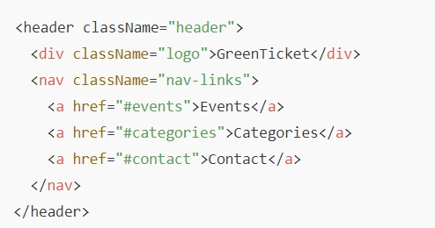
LandingPage.JS
This navigates the user to the Book Ticket Page (/BookTicket) when they click the Book Ticket button.
Contains navigation links: "Events", "Categories", and "Contact".

Slide 14
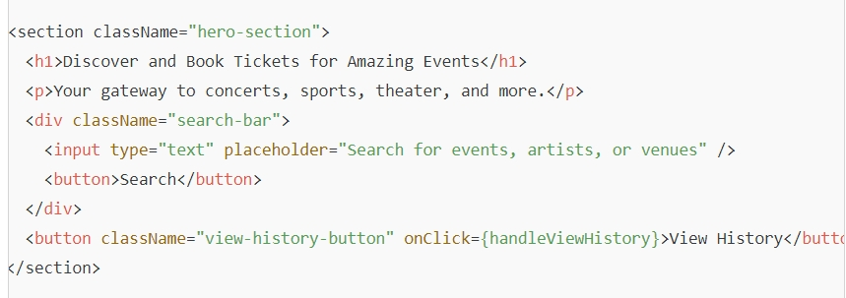
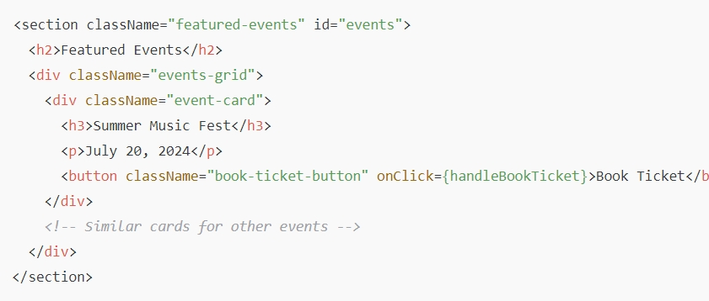
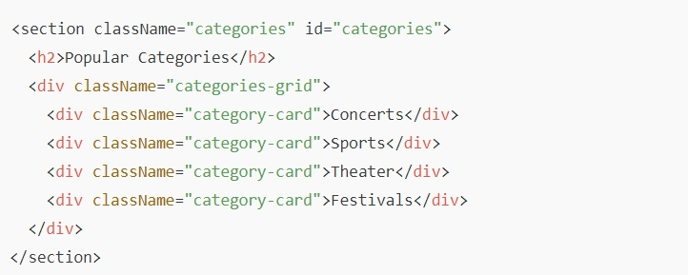
What the page looks like
A Search Bar to look for events.
A View History button that navigates to the history page.
Displays a grid of events like "Summer Music Fest", "Championship Game", and "Broadway Show".
Each event has a Book Ticket button, which navigates to the Book Ticket page.
Shows popular categories like Concerts, Sports, Theater, and Festivals.

Slide 15
Ticket booking
1. Imports:
The code begins by importing necessary modules and components:
- React and Component from the 'react' library for creating class-based components.
- Form and Button from 'react-bootstrap' for UI elements.
- useNavigate from 'react-router-dom' for navigation.
- Custom styles from 'TicketBooking.css'.
- axios for making HTTP requests.
2. withNavigation Function:
This function is a higher-order component (HOC) that wraps a class-based component to provide navigation capabilities using useNavigate.

Slide 16
3. BookTicket Class Component:
- Constructor:
Initializes the component's state with properties: name, email, ticketType, and date. It also binds methods to the class.
- State Change Methods:
These methods update the component's state when the user inputs data:
- onChangeName
- onChangeEmail
- onChangeTicketType
- onChangeDate
- onSubmit Method:
This asynchronous method handles form submission:
- Prevents the default form submission behavior.
- Collects the state values into a newTicket object.
- Sends a POST request to the server to book a ticket using axios.
- Alerts the user upon successful booking and navigates to the landing page.
- Catches and logs any errors, alerting the user if the booking fails.
4. Exporting the Component:
The BookTicket component is wrapped with the withNavigation function to provide navigation capabilities and then exported.

